Slide 1
Bridge Course

Slide 2
Syllabus
Operating Systems (Lecture - 20 Hours)
Overview of operating systems, functionalities and characteristics of OS. Concept of a process, operations on processes, process states, concurrent processes, process control block, process context, processor scheduling, scheduling algorithms, problems of concurrent processes, critical sections, mutual exclusion, synchronisation, producer and consumer processes, deadlock.
Inter Process Communication (IPC), Memory organisation and management, Storage allocation, Virtual memory concepts. File organisation: blocking and buffering, file descriptor, directory structure
Reference Book:
A. Silberchatz et.al., “Operating System Concepts”, 9th Edition Wiley (2015)
Online Resource:
https://www.coursera.org/learn/os-power-user

Slide 3
Introduction to computers
Agenda
Applications of Computers
Introduction
Hardware/Software
Block Diagram
Components
Buses
Computer Networks

Slide 4
Continues..
Applications of Computers
In Business and Industry
In Publication Field
In Education Field
In Government Organizations
In Medical Field
In Science Field
In Entertainment Field

Slide 5
Computers
Definition
Computer is an electronic device which accepts data as input through input device, process the data according to the instructions, stores data if required and provides output through appropriate output device.
Computer can be divided into two:-
Hardware
Tangible functions
Software
Instructions working over hardware.

Slide 6
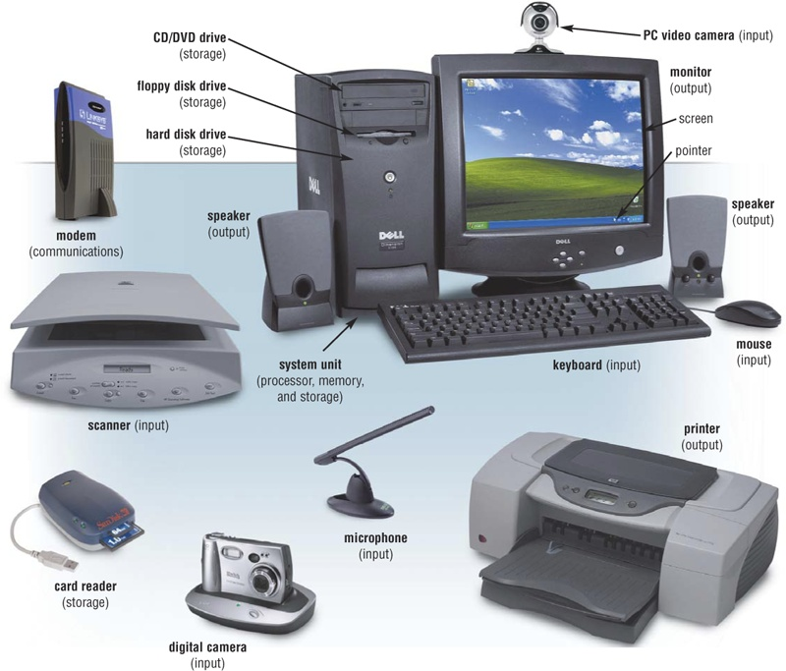

Slide 7
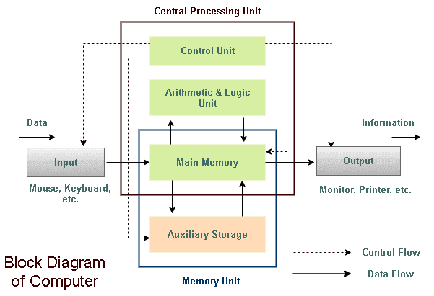
Block Diagram

Slide 8
Parts of a Computer
Input Devices (Keyboard, Mouse, etc.)
Output Devices (Monitor, Speakers, etc.)
Central Processing Unit (CPU) and memory

Slide 9
CPU(central processing unit)
Box-like case containing electronic components used to process data
It is the brain of the computer.
The ALU and the Control Unit (CU) of a computer system are jointly known as the central processing unit.
CPU performs actual processing of data, according to instructions from programs.

Slide 10
Memory
Types of Memory
Registers
RAM(Random Access Memory)
ROM(Read Only Memory)
Secondary Storage Devices(considered as input/output device)

Slide 11
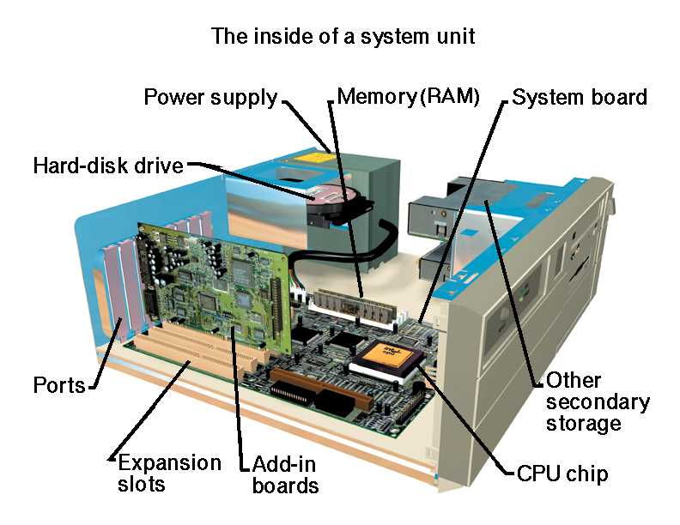
Inside a CPU

Slide 12
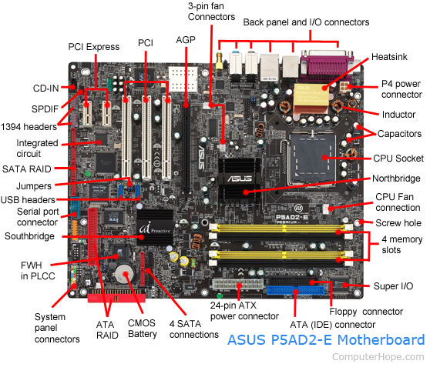
Motherboard

Slide 13
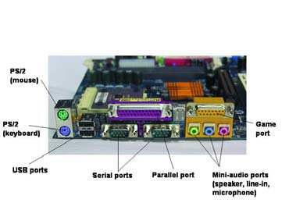
Ports

Slide 14
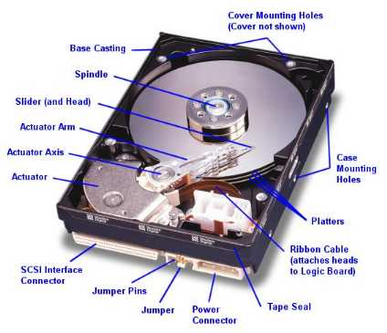
Hard Disk

Slide 15
Software
Two types
System Software
Operating system, Assemblers, etc.
Application software
Examples

Slide 16


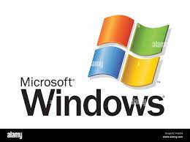



Some OSs

Slide 17
Operating System
Definition
A program that acts as an intermediary between a user of a computer and the computer hardware.
Goals of Operating System
Execute user programs and make solving user problems easier
Make the computer system convenient to use
Use the computer hardware in an efficient manner

Slide 18
Computer System Structure
Computer system can be divided into four components:
Hardware – provides basic computing resources
CPU, memory, I/O devices
Operating system
Controls and coordinates use of hardware among various applications and users
Application programs – define the ways in which the system resources are used to solve the computing problems of the users
Word processors, compilers, web browsers, database systems, video games
Users
People, machines, other computers

Slide 19
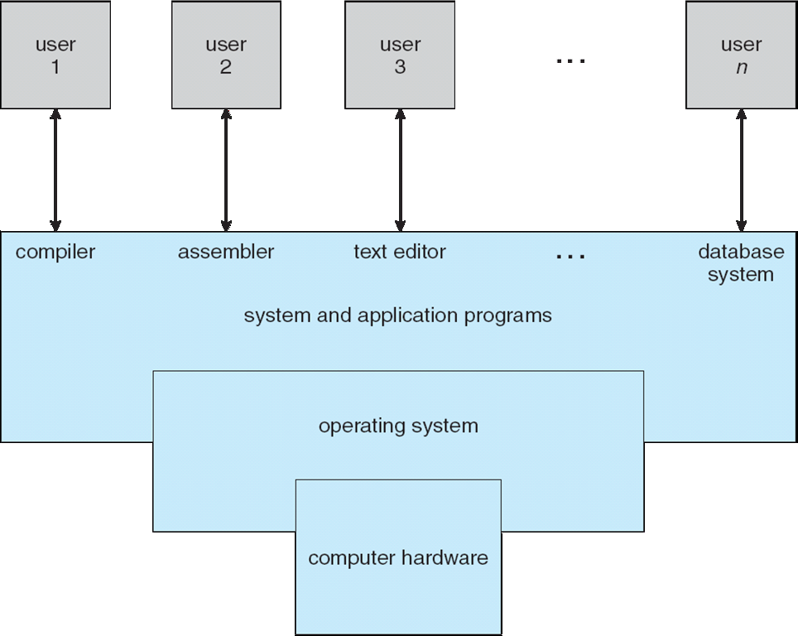

Slide 20
What Operating Systems Do?
Depends on the point of view
Users want convenience, ease of use and good performance
Don’t care about resource utilization
But shared computer such as mainframe or minicomputer must keep all users happy
Users of dedicate systems such as workstations have dedicated resources but frequently use shared resources from servers
Handheld computers are resource poor, optimized for usability and battery life
Some computers have little or no user interface, such as embedded computers in devices and automobiles

Slide 21
Operating System Definition
OS is a resource allocator
Manages all resources
Decides between conflicting requests for efficient and fair resource use
OS is a control program
Controls execution of programs to prevent errors and improper use of the computer

Slide 22
What happens when a computer is switched on?
Bootstrap program is loaded at power-up or reboot
Typically stored in ROM or EPROM, generally known as firmware
Initializes all aspects of system
Loads operating system kernel and starts execution

Slide 23
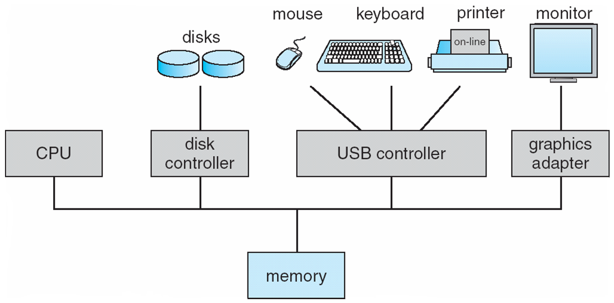
Computer System Organization
Computer-system operation
One or more CPUs, device controllers connect through common bus providing access to shared memory
Concurrent execution of CPUs and devices competing for memory cycles

Slide 24
Computer-System Operation
I/O devices and the CPU can execute concurrently
Each device controller is in charge of a particular device type
Each device controller has a local buffer
CPU moves data from/to main memory to/from local buffers
I/O is from the device to local buffer of controller
Device controller informs CPU that it has finished its operation by causing an interrupt

Slide 25
Introduction
Program
It is a collection of instructions.
When it is a program it is a passive collection of instructions.
Process
It is an instance of a running program.
Two or more separate process could be running the same program independently at the same time.
Difference
A computer program itself is just a passive collection of instructions, whereas process is the actual execution of those instructions.

Slide 26
Continues..
Task
It is a unit of execution or unit of work in a software application.
A task is a set of instructions currently executing, a process is a bundle of instructions or programs being executed.
Difference
Job is work that needs to be done.
A task is a piece of work that needs to be done.
The process is a series of actions that is done for a particular purpose. Job and task define the work to be done, whereas process defines the way the work can be done or how the work should be done.

Slide 27
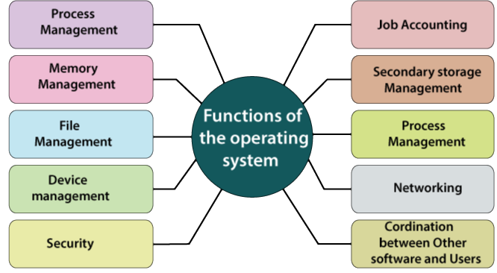
Functions of an Operating System

Slide 28
Interrupts Management
Interrupt
An interrupt is a signal emitted by a device attached to a computer or from a program within the computer.
It is not just interruption.
An address will be transferred with the interrupt.
Functions
IVT(Interrupt Vector Table) and ISR(Interrupt Service Routine)
Polling.

Slide 29
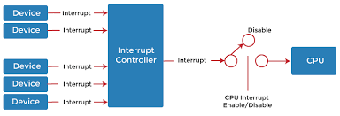
Interrupts

Slide 30
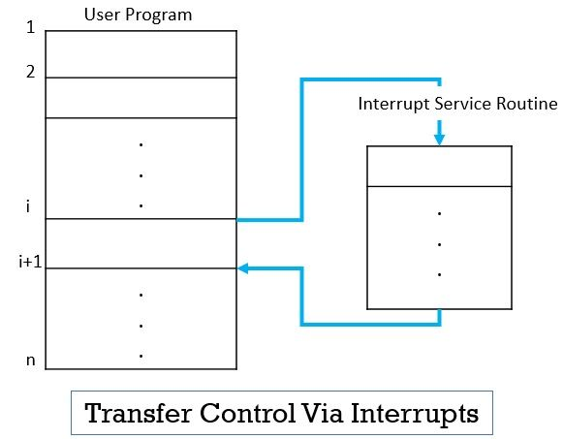
How Control is transferred when an interrupt is occurred?

Slide 31
Memory Management
Main memory – only large storage media that the CPU can access directly
Random access
Typically volatile
Secondary storage – extension of main memory that provides large nonvolatile storage capacity
Hard disks – rigid metal or glass platters covered with magnetic recording material
Disk surface is logically divided into tracks, which are subdivided into sectors
The disk controller determines the logical interaction between the device and the computer
Solid-state disks – faster than hard disks, nonvolatile
Various technologies
Becoming more popular

Slide 32
Continues..
Storage systems organized in hierarchy
Speed
Cost
Volatility
Caching – copying information into faster storage system; main memory can be viewed as a cache for secondary storage
Device Driver for each device controller to manage I/O
Provides uniform interface between controller and kernel

Slide 33
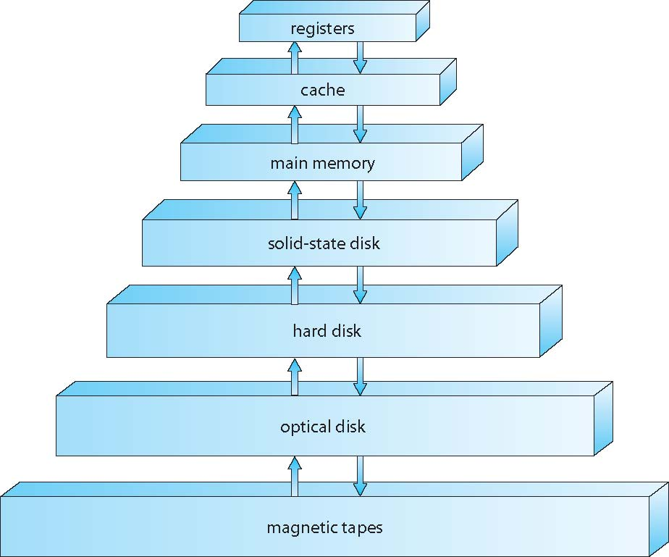
Memory Hierarchy

Slide 34
Caching
Information in use copied from slower to faster storage temporarily
Faster storage (cache) checked first to determine if information is there
If it is, information used directly from the cache (fast)
If not, data copied to cache and used there
Cache smaller than storage being cached
Cache management important design problem
Cache size and replacement policy

Slide 35
Direct Memory Access(DMA)
Used for high-speed I/O devices able to transmit information at close to memory speeds
Device controller transfers blocks of data from buffer storage directly to main memory without CPU intervention
Only one interrupt is generated per block, rather than the one interrupt per byte

Slide 36
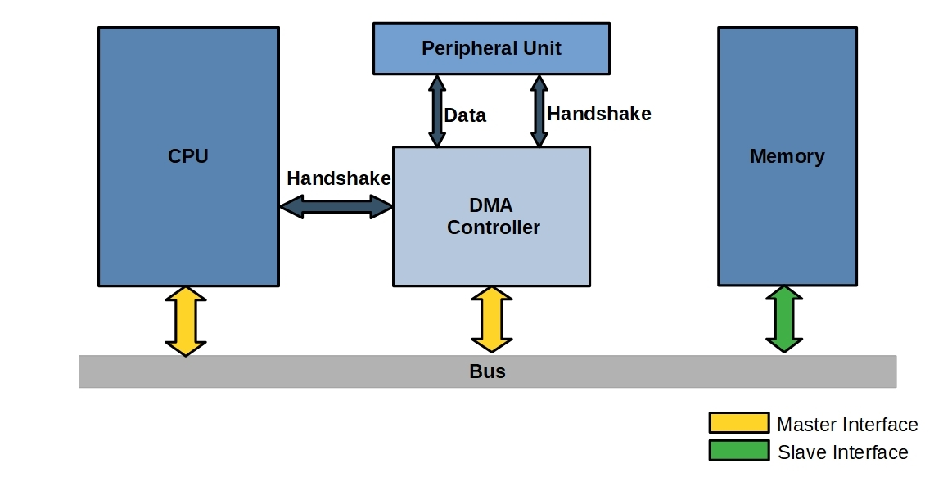
Continues..

Slide 37
Computer-System Architecture
Most systems use a single general-purpose processor
Most systems have special-purpose processors as well
Multiprocessors systems growing in use and importance
Also known as parallel systems, tightly-coupled systems
Advantages include:
Increased throughput
Economy of scale
Increased reliability – graceful degradation or fault tolerance
Two types:
Asymmetric Multiprocessing – each processor is assigned a specie task.
Symmetric Multiprocessing – each processor performs all tasks

Slide 38
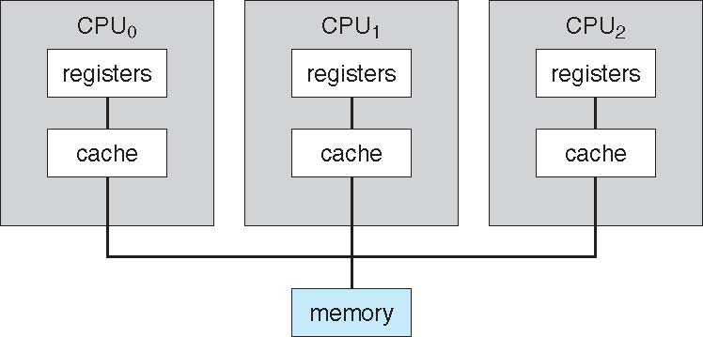
Symmetric Multiprocessing Architecture

Slide 39
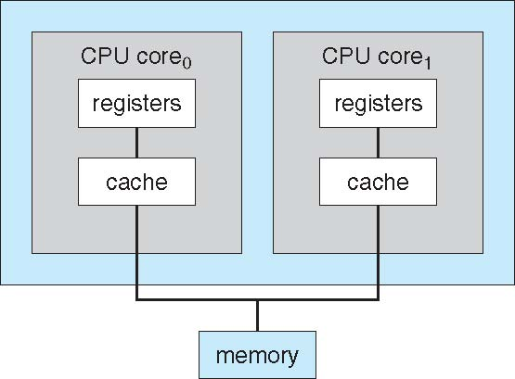
Dual-Core Design
Multi-chip and multicore
Systems containing all chips
Chassis containing multiple separate systems

Slide 40
Clustered Systems
Like multiprocessor systems, but multiple systems working together
Usually sharing storage via a storage-area network (SAN)
Provides a high-availability service which survives failures
Asymmetric clustering has one machine in hot-standby mode
Symmetric clustering has multiple nodes running applications, monitoring each other
Some clusters are for high-performance computing (HPC)
Applications must be written to use parallelization
Some have distributed lock manager (DLM) to avoid conflicting operations

Slide 41
Continues..

Slide 42
Multiprogramming
Multiprogramming (Batch system)
It is for improving the efficiency
Single user cannot keep CPU and I/O devices busy at all times
Multiprogramming organizes jobs (code and data) so CPU always has one to execute
A subset of total jobs in system is kept in memory
One job selected and run via job scheduling
When it has to wait (for I/O for example), OS switches to another job

Slide 43
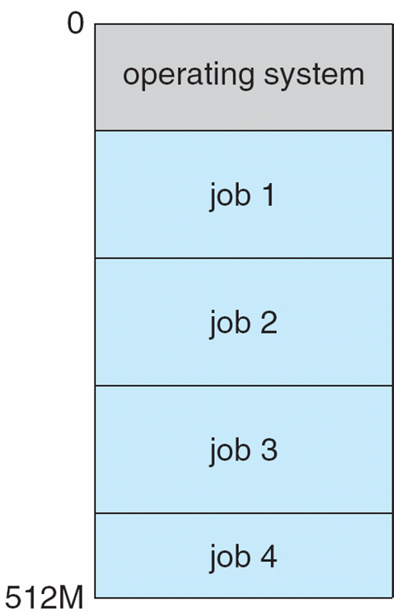
Memory Layout for Multi-programmed System

Slide 44
Timesharing
Timesharing (multitasking) is logical extension in which CPU switches jobs so frequently that users can interact with each job while it is running, creating interactive computing
Response time should be < 1 second
Each user has at least one program executing in memory process
If several jobs ready to run at the same time  CPU scheduling
If processes don’t fit in memory, swapping moves them in and out to run
Virtual memory allows execution of processes not completely in memory

Slide 45
Process Management
A process is a program in execution. It is a unit of work within the system. Program is a passive entity, process is an active entity.
Process needs resources to accomplish its task
CPU, memory, I/O, files
Initialization data
Process termination requires reclaim of any reusable resources
Single-threaded process has one program counter specifying location of next instruction to execute
Process executes instructions sequentially, one at a time, until completion
Multi-threaded process has one program counter per thread
Typically system has many processes, some user, some operating system running concurrently on one or more CPUs
Concurrency by multiplexing the CPUs among the processes / threads

Slide 46
Process Management Activities
The operating system is responsible for the following activities in connection with process management:
Creating and deleting both user and system processes
Suspending and resuming processes
Providing mechanisms for process synchronization
Providing mechanisms for process communication
Providing mechanisms for deadlock handling

Slide 47
Memory Management
To execute a program all (or part) of the instructions must be in memory
All (or part) of the data that is needed by the program must be in memory.
Memory management determines what is in memory and when
Optimizing CPU utilization and computer response to users
Memory management activities
Keeping track of which parts of memory are currently being used and by whom
Deciding which processes (or parts thereof) and data to move into and out of memory
Allocating and deallocating memory space as needed

Slide 48
Storage Management
OS provides uniform, logical view of information storage
Abstracts physical properties to logical storage unit - file
Each medium is controlled by device (i.e., disk drive, tape drive)
Varying properties include access speed, capacity, data-transfer rate, access method (sequential or random)
File-System management
Files usually organized into directories
Access control on most systems to determine who can access what
OS activities include
Creating and deleting files and directories
Primitives to manipulate files and directories
Mapping files onto secondary storage
Backup files onto stable (non-volatile) storage media

Slide 49
Mass-Storage Management
Usually disks used to store data that does not fit in main memory or data that must be kept for a “long” period of time
Proper management is of central importance
Entire speed of computer operation hinges on disk subsystem and its algorithms
OS activities
Free-space management
Storage allocation
Disk scheduling
Some storage need not be fast
Tertiary storage includes optical storage, magnetic tape
Still must be managed – by OS or applications
Varies between WORM (write-once, read-many-times) and RW (read-write)

Slide 50
Performance of Various Levels of Storage

Slide 51
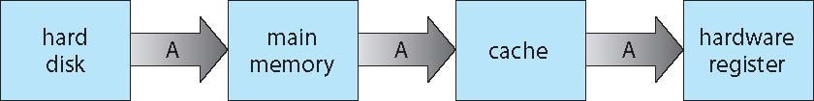
Migration of data “A” from Disk to Register
Multitasking environments must be careful to use most recent value, no matter where it is stored in the storage hierarchy
Multiprocessor environment must provide cache coherency in hardware such that all CPUs have the most recent value in their cache
Distributed environment situation even more complex
Several copies of a datum can exist

Slide 52
I/O Subsystem
One purpose of OS is to hide peculiarities of hardware devices from the user
I/O subsystem responsible for
Memory management of I/O including buffering (storing data temporarily while it is being transferred), caching (storing parts of data in faster storage for performance), spooling (the overlapping of output of one job with input of other jobs)
General device-driver interface
Drivers for specific hardware devices
System Bus

Slide 53
Types of OSs
Traditional OS
Mobile OS
Distributed OS
Client-Server OS
Cloud Computing OS
Open-Source OS
Real-Time OS

Slide 54
Concept of OS
An operating system executes a variety of programs:
Batch system – jobs
Time-shared systems – user programs or tasks
Textbook uses the terms job and process almost interchangeably
Process – a program in execution; process execution must progress in sequential fashion
Multiple parts
The program code, also called text section
Current activity including program counter, processor registers
Stack containing temporary data
Function parameters, return addresses, local variables
Data section containing global variables
Heap containing memory dynamically allocated during run time

Slide 55
Continues..
Program is passive entity stored on disk (executable file), process is active
Program becomes process when executable file loaded into memory
Execution of program started via GUI mouse clicks, command line entry of its name, etc
One program can be several processes
Consider multiple users executing the same program

Slide 56
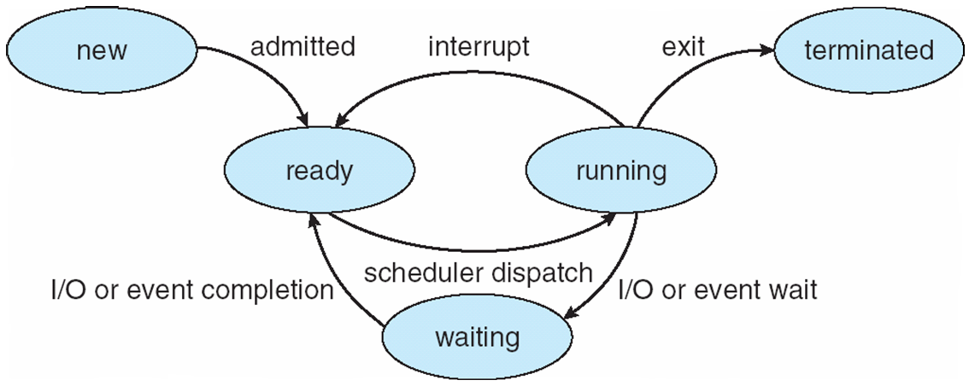
Process States

Slide 57
Continues..
As a process executes, it changes state
new: The process is being created
running: Instructions are being executed
waiting: The process is waiting for some event to occur
ready: The process is waiting to be assigned to a processor
terminated: The process has finished execution

Slide 58
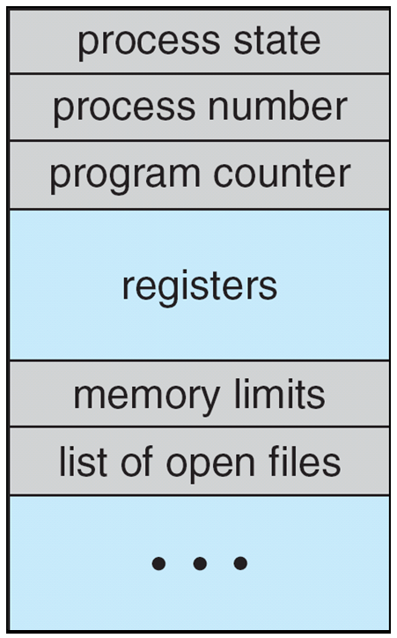
Process Control Block(PCB)
Information associated with each process
(also called task control block)
Process state – running, waiting, etc.
Program counter – location of instruction to next execute
CPU registers – contents of all process-centric registers
CPU scheduling information- priorities, scheduling queue pointers
Memory-management information – memory allocated to the process
Accounting information – CPU used, clock time elapsed since start, time limits
I/O status information – I/O devices allocated to process, list of open files

Slide 59
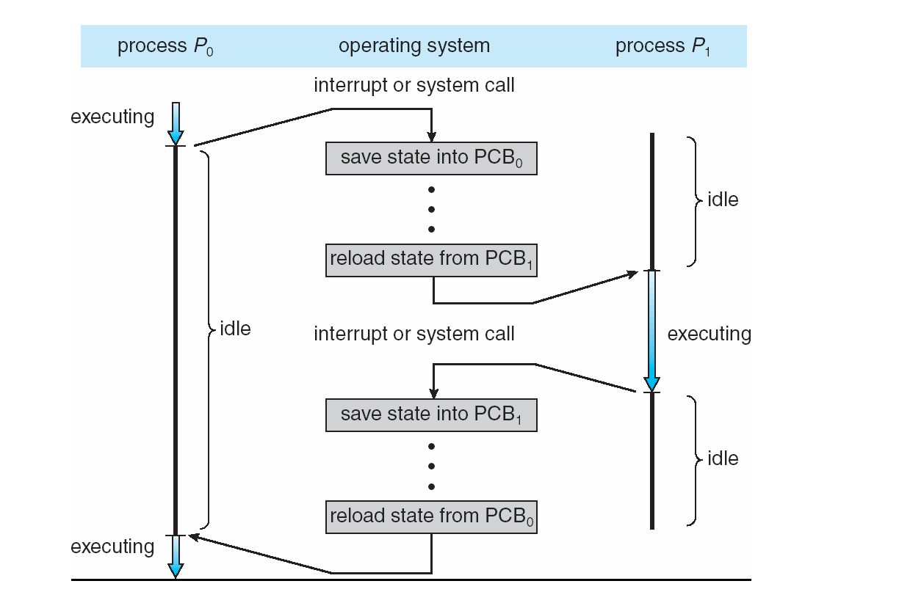
CPU Switch From Process to Process

Slide 60
Process Scheduling
Maximize CPU use, quickly switch processes onto CPU for time sharing
Process scheduler selects among available processes for next execution on CPU
Maintains scheduling queues of processes
Job queue – set of all processes in the system
Ready queue – set of all processes residing in main memory, ready and waiting to execute
Device queues – set of processes waiting for an I/O device
Processes migrate among the various queues

Slide 61
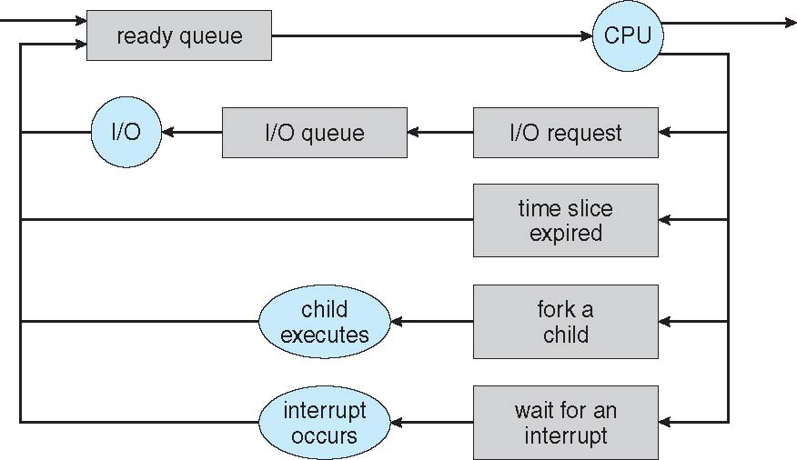
Continues..
Queueing diagram represents queues, resources, flows

Slide 62
Operations on Processes
System must provide mechanisms for:
process creation,
process termination,
and so on as detailed next

Slide 63
Process Creation
Parent process create children processes, which, in turn create other processes, forming a tree of processes
Generally, process identified and managed via a process identifier (pid)
Resource sharing options
Parent and children share all resources
Children share subset of parent’s resources
Parent and child share no resources
Execution options
Parent and children execute concurrently
Parent waits until children terminate

Slide 64
A Tree of Processes in Linux

Slide 65
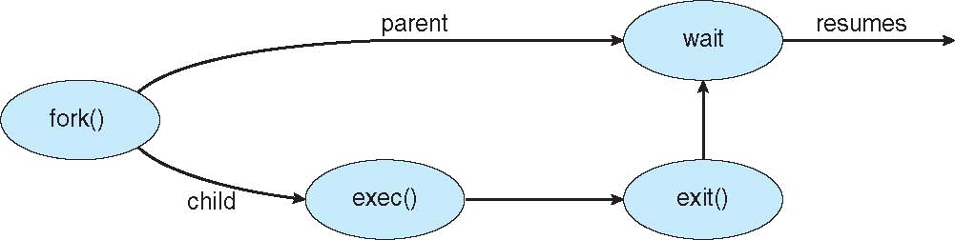
Continues..
Address space
Child duplicate of parent
Child has a program loaded into it
UNIX examples
fork() system call creates new process
exec() system call used after a fork() to replace the process’ memory space with a new program

Slide 66
Process Termination
Process executes last statement and then asks the operating system to delete it using the exit() system call.
Returns status data from child to parent (via wait())
Process’ resources are deallocated by operating system
Parent may terminate the execution of children processes using the abort() system call. Some reasons for doing so:
Child has exceeded allocated resources
Task assigned to child is no longer required
The parent is exiting and the operating systems does not allow a child to continue if its parent terminates

Slide 67
Interprocess Communication
Processes within a system may be independent or cooperating
Cooperating process can affect or be affected by other processes, including sharing data
Reasons for cooperating processes:
Information sharing
Computation speedup
Modularity
Convenience
Cooperating processes need interprocess communication (IPC)
Two models of IPC
Shared memory
Message passing

Slide 68
Communications Models
(a) Message passing. (b) shared memory.

Slide 69
Cooperating Processes
Independent process cannot affect or be affected by the execution of another process
Cooperating process can affect or be affected by the execution of another process

Slide 70
Producer-Consumer Problem
Paradigm for cooperating processes, producer process produces information that is consumed by a consumer process
unbounded-buffer places no practical limit on the size of the buffer
bounded-buffer assumes that there is a fixed buffer size

Slide 71
Interprocess Communication – Shared Memory
An area of memory shared among the processes that wish to communicate
The communication is under the control of the users processes not the operating system.
Major issues is to provide mechanism that will allow the user processes to synchronize their actions when they access shared memory.

Slide 72
Interprocess Communication – Message Passing
Mechanism for processes to communicate and to synchronize their actions
Message system – processes communicate with each other without resorting to shared variables
IPC facility provides two operations:
send(message)
receive(message)
The message size is either fixed or variable
If processes P and Q wish to communicate, they need to:
Establish a communication link between them
Exchange messages via send/receive

Slide 73
Continues..
Implementation of communication link
Physical:
Shared memory
Hardware bus
Network
Logical:
Direct or indirect
Synchronous or asynchronous
Automatic or explicit buffering

Slide 74
Direct Communication
Processes must name each other explicitly:
send (P, message) – send a message to process P
receive(Q, message) – receive a message from process Q
Properties of communication link
Links are established automatically
A link is associated with exactly one pair of communicating processes
Between each pair there exists exactly one link
The link may be unidirectional, but is usually bi-directional

Slide 75
Indirect Communication
Messages are directed and received from mailboxes (also referred to as ports)
Each mailbox has a unique id
Processes can communicate only if they share a mailbox
Properties of communication link
Link established only if processes share a common mailbox
A link may be associated with many processes
Each pair of processes may share several communication links
Link may be unidirectional or bi-directional
Operations
create a new mailbox (port)
send and receive messages through mailbox
destroy a mailbox
Primitives are defined as:
send(A, message) – send a message to mailbox A
receive(A, message) – receive a message from mailbox A

Slide 76
Synchronization
Message passing may be either blocking or non-blocking
Blocking is considered synchronous
Blocking send -- the sender is blocked until the message is received
Blocking receive -- the receiver is blocked until a message is available
Non-blocking is considered asynchronous
Non-blocking send -- the sender sends the message and continue
Non-blocking receive -- the receiver receives:
A valid message, or
Null message
Different combinations possible
If both send and receive are blocking, there should be a common meeting point.

Slide 77
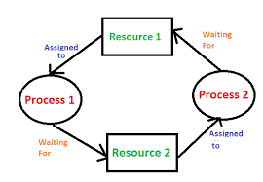
Deadlocks
It is a situation where a set of process are blocked because each process is holding a resource and waiting for another resource acquired by some other process.

Slide 78
Condition for deadlock
Mutual Exclusion | Hold and Wait
No Preemption | Circular Wait

Slide 79
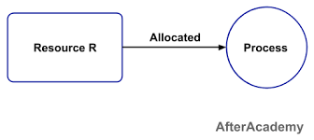
Mutual Exclusion
A resource can be held by only one process at a time.
If a process P1 is using some resource R at a particular instant of time, then some other process P2 can't hold or use the same resource R at that particular instant of time.
The process P2 can make a request for that resource R but it can't use that resource simultaneously with process P1

Slide 80
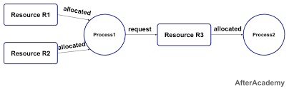
Hold and Wait
A process can hold a number of resources at a time and at the same time, it can request for other resources that are being held by some other process.
For example, a process P1 can hold two resources R1 and R2 and at the same time, it can request some resource R3 that is currently held by process P2.

Slide 81
No Preemption
A resource can't be preempted from the process by another process, forcefully.
For example, if a process P1 is using some resource R, then some other process P2 can't forcefully take that resource. If it is so, then what's the need for various scheduling algorithm. The process P2 can request for the resource R and can wait for that resource to be freed by the process P1.

Slide 82
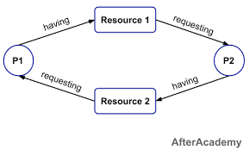
Circular Wait
Circular wait is a condition when the first process is waiting for the resource held by the second process, the second process is waiting for the resource held by the third process, and so on.
At last, the last process is waiting for the resource held by the first process. So, every process is waiting for each other to release the resource and no one is releasing their own resource. Everyone is waiting here for getting the resource. This is called a circular wait.

Slide 83
Virtual memory
In modern computers, physical main memory is not enough for the large address space of the processor.
When a program does not completely fit into the main memory, the parts of it not currently being executed are stored on secondary storage devices.
Techniques that automatically move program and data blocks into the physical main memory when they are required for execution are called virtual-memory techniques.
When a new segment of a program is to be moved into the full memory, it must replace another segment already in the memory.
So the segments have to be transferred between main memory and the secondary memory automatically by the OS.
Virtual addresses will be translated into physical addresses.

Slide 84
Continues..
Technique that automatically move program and data block into main memory when they are required for execution are called virtual memory.
So the processor can address instruction and data space much more the actual size.
The binary addresses that the processor issues is called virtual or logical address.
This virtual addresses are translated to physical addresses by the combination of hardware and software components.
A unit called memory management unit(MMU) translates virtual address to physical address.

Slide 86
Address Translation
All programs and data are composed of fixed-length units called pages, each of which consists of a block of words that occupy contiguous locations in the main memory.
Pages commonly ranges from 2K to 16K in length.
Page cannot be too small or too large.
The virtual memory mechanism bridges the size and speed gaps between the main memory and secondary storage – similar to cache.
The cache and virtual memory bridges the speed gap between the processor and the main memory – but cache uses hardware and virtual memory uses software.
A virtual-memory address translation method based on fixed length pages.

Slide 87
Continues..
Each virtual address has 2 parts :-
virtual page number(high-order)
offset(low-order)
which specifies the location with in the page.
Information about the main memory location of each page is kept in a page table.
The contents of the page table are where the page is stored and current status of the page.
An area in the main memory that can hold one page is called page frame.
The starting address of the page table is kept in a page table base register.
By adding the virtual page number to content of page table base register, the address of the corresponding entry in the page table is obtained.
The content of this location gives the starting address of the page if that page currently resides in the main memory.

Slide 88
Continues..
PTBR holds
the address of
the page table.
Page table address
Virtual page number
Offset
Virtual address is
interpreted as page
number and offset.
+
PTBR + virtual
page number provide
the entry of the page
in the page table.
PAGE TABLE
This entry has the starting location
of the page.
Page table holds information
about each page. This includes
the starting address of the page
in the main memory.
Control
Page frame
bits
in memory
Page frame
Offset
Physical address in main memory

Slide 89
Control bits describes the one bit status of the page whether it is the main memory or not.
Another bit indicates whether the page has been modified during its residency in the memory.
By using this bit the memory determines whether the modified page has been updated.
Other control bits indicate various restrictions that may be imposed on accessing the page.
Example: read and write permission, read only permission, etc.
Other page table information is used by MMU for read and write access.
The page table is situated inside MMU.
MMU is normally a part of the processor, it is impossible to include a complete page table on the processor.
So page table is kept in main memory.
And a copy of a small portion of the page table can be accommodated within the MMU.

